Slide 1
Making smart queries with data
Modern AI Pro: Level 1
Balaji Viswanathan

Slide 2
Key goals.
Load an external dataset
Convert to SQL
Visualize data
We will use a world history dataset.
The format most of the world’s data is in.
With Word Cloud and Geopandas.
Generate Text Embeddings
Relational data to vector DB
RAG with LLM
Generate vectors from text.
How do we make SQL DB highly usable.
Make LLM use multiple data chunks.

Slide 3
How will you use this?
Your company might want to utilize the massive chunks of relational data sitting in its databases and tap its full value. Using visualization techniques and LLM based RAGs you can dazzle your management and customers.

Slide 4
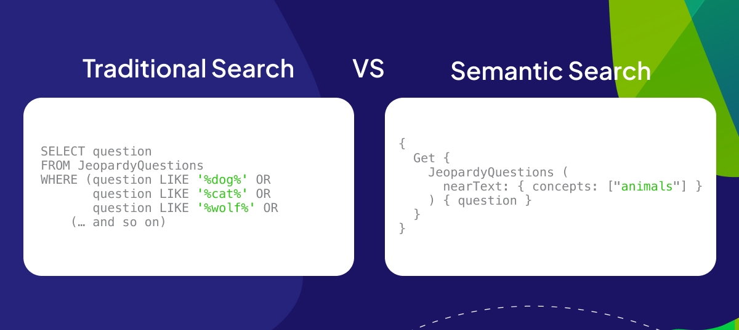

Slide 5
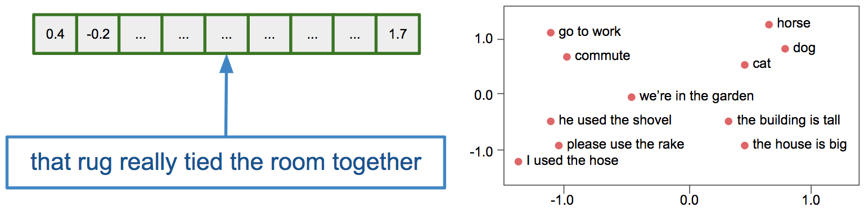
A new way of thinking about data.

Slide 6
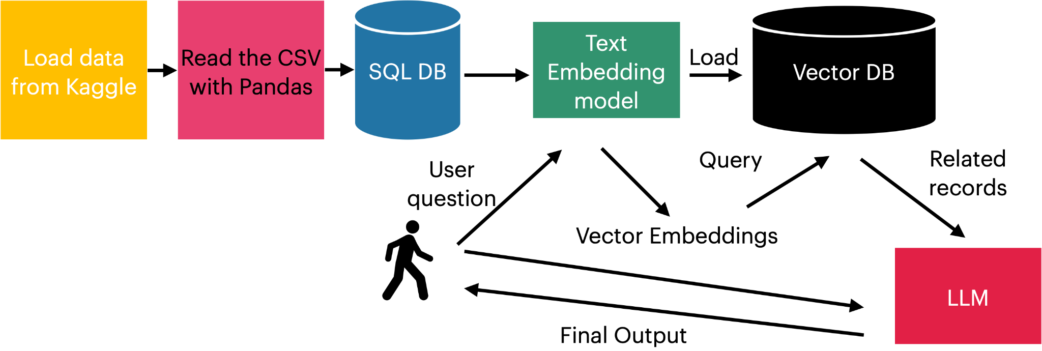
The key flow of the session

Slide 7
Let’s get started

Slide 8
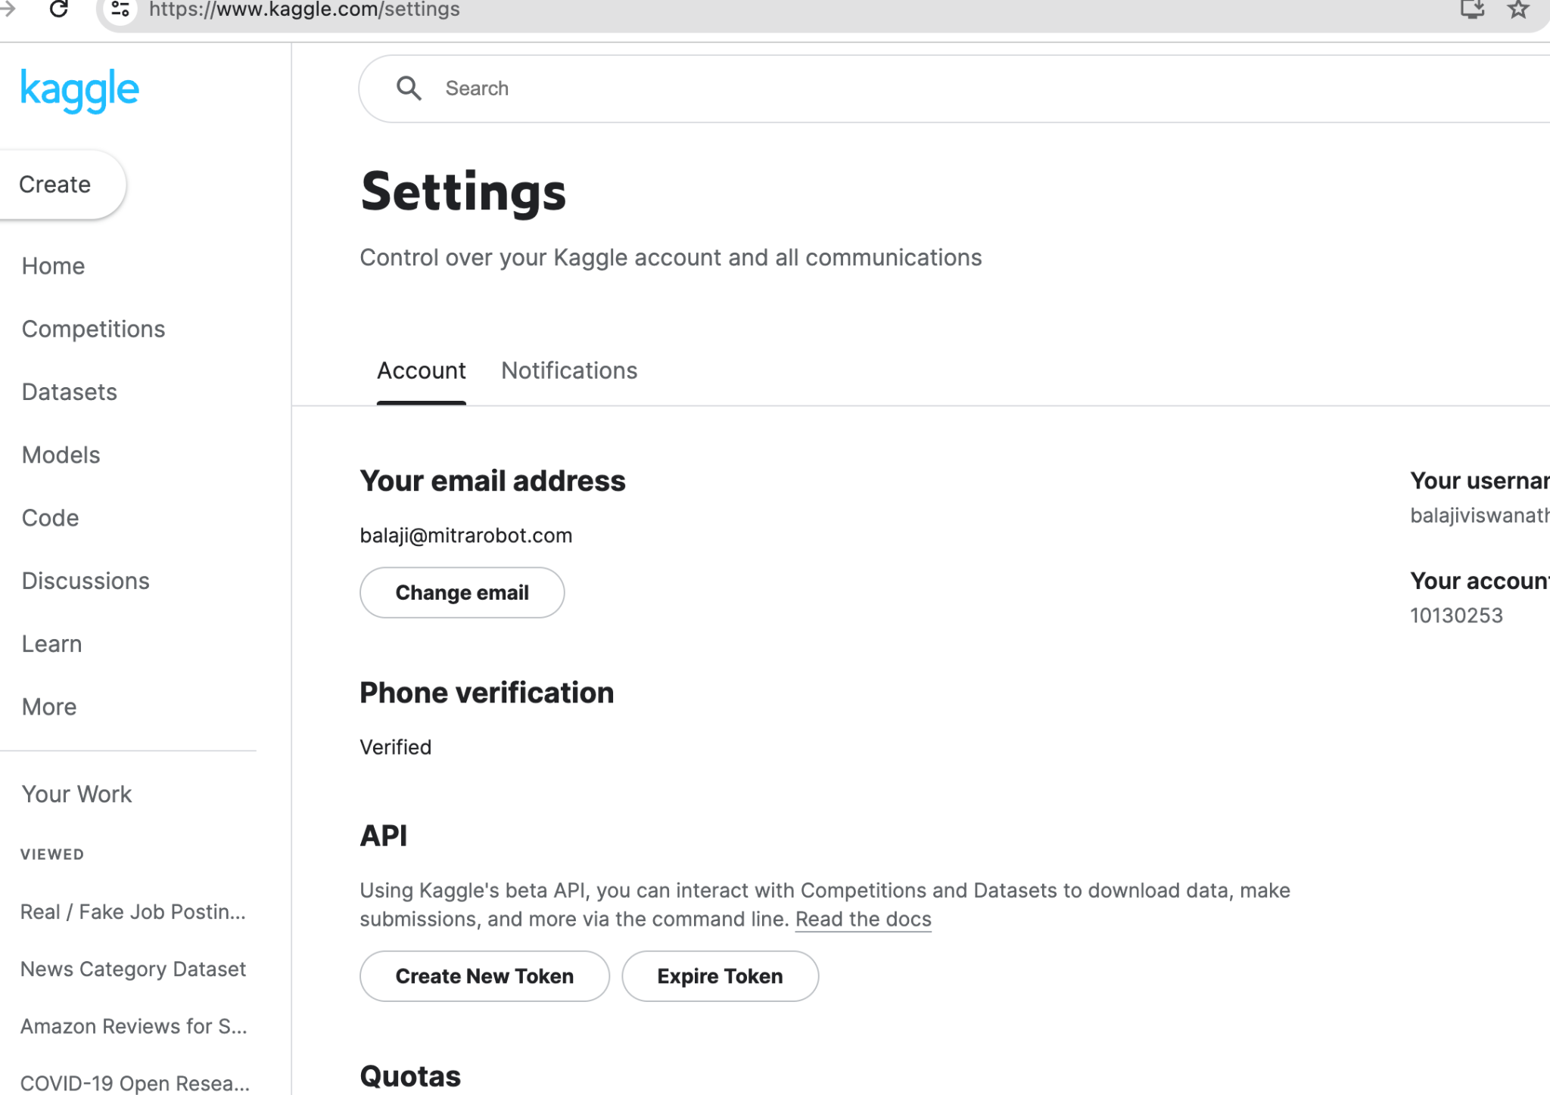
Get the dataset from Kaggle
! pip -q install kaggle
! mkdir ~/.kaggle
! cp kaggle.json ~/.kaggle
! chmod 600 ~/.kaggle/kaggle.json
! kaggle datasets download -d 'saketk511/world-important-events-ancient-to-modern'
! unzip /content/world-important-events-ancient-to-modern.zip

Slide 9
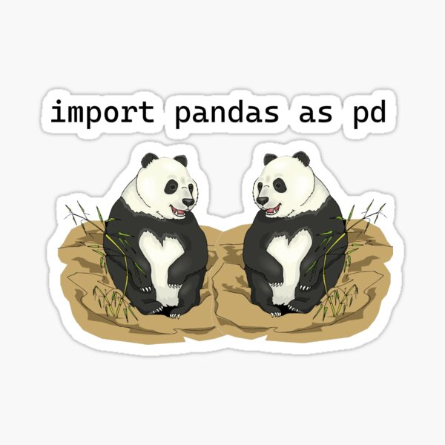
2. Load the data with Pandas

Slide 10
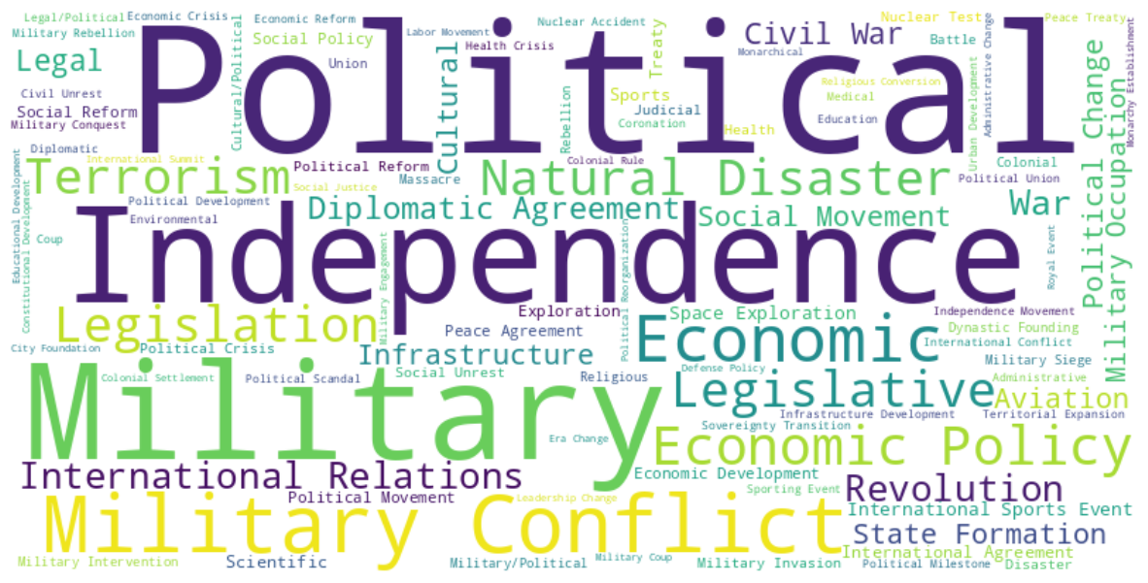
3. Visualize the data

Slide 11




4. From Dataframe to SQL DB

Slide 12
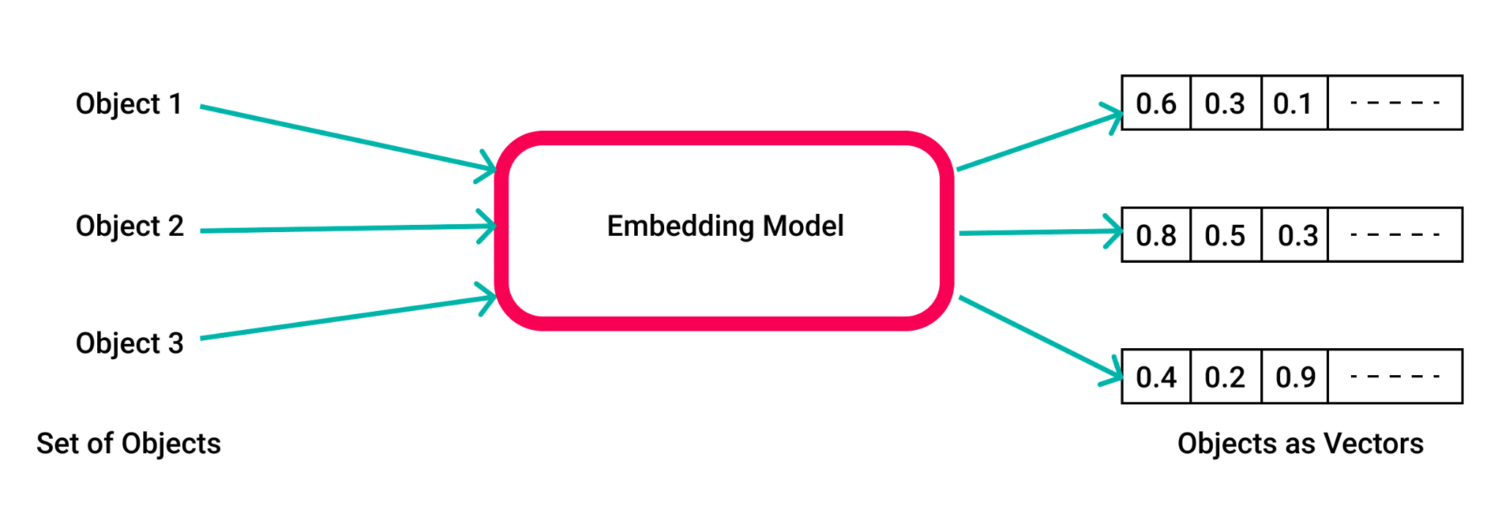
5. Use an embedding model to generate vectors

Slide 13
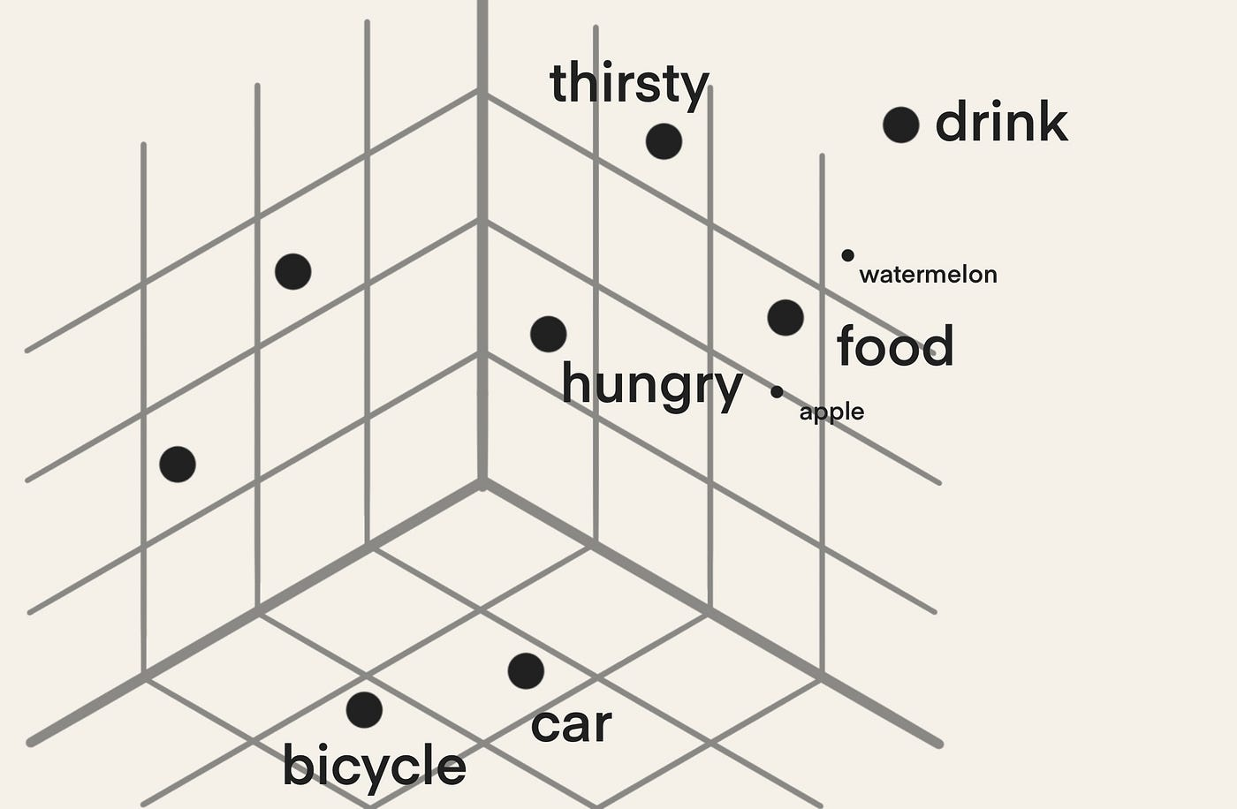
6. Load the embeddings into the Vector DB and query.
We are grouping data by concepts rather than mere text.

Slide 14
Get the LLMs work on your data!
Can you combine your internal data in incredible new ways?

Slide 15
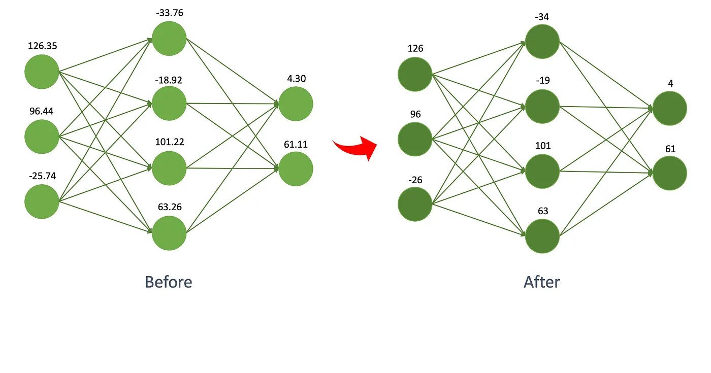
7. Quantize the chosen model [Mistral]

Slide 16
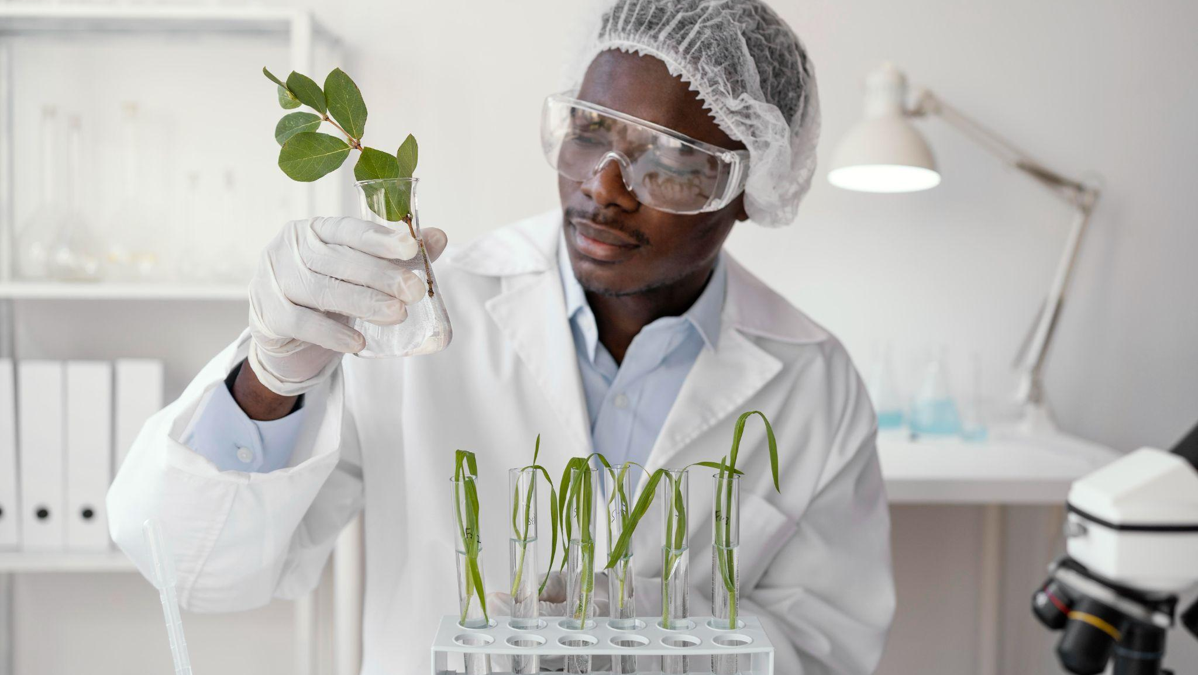
8. Load the LLM in memory.

Slide 17
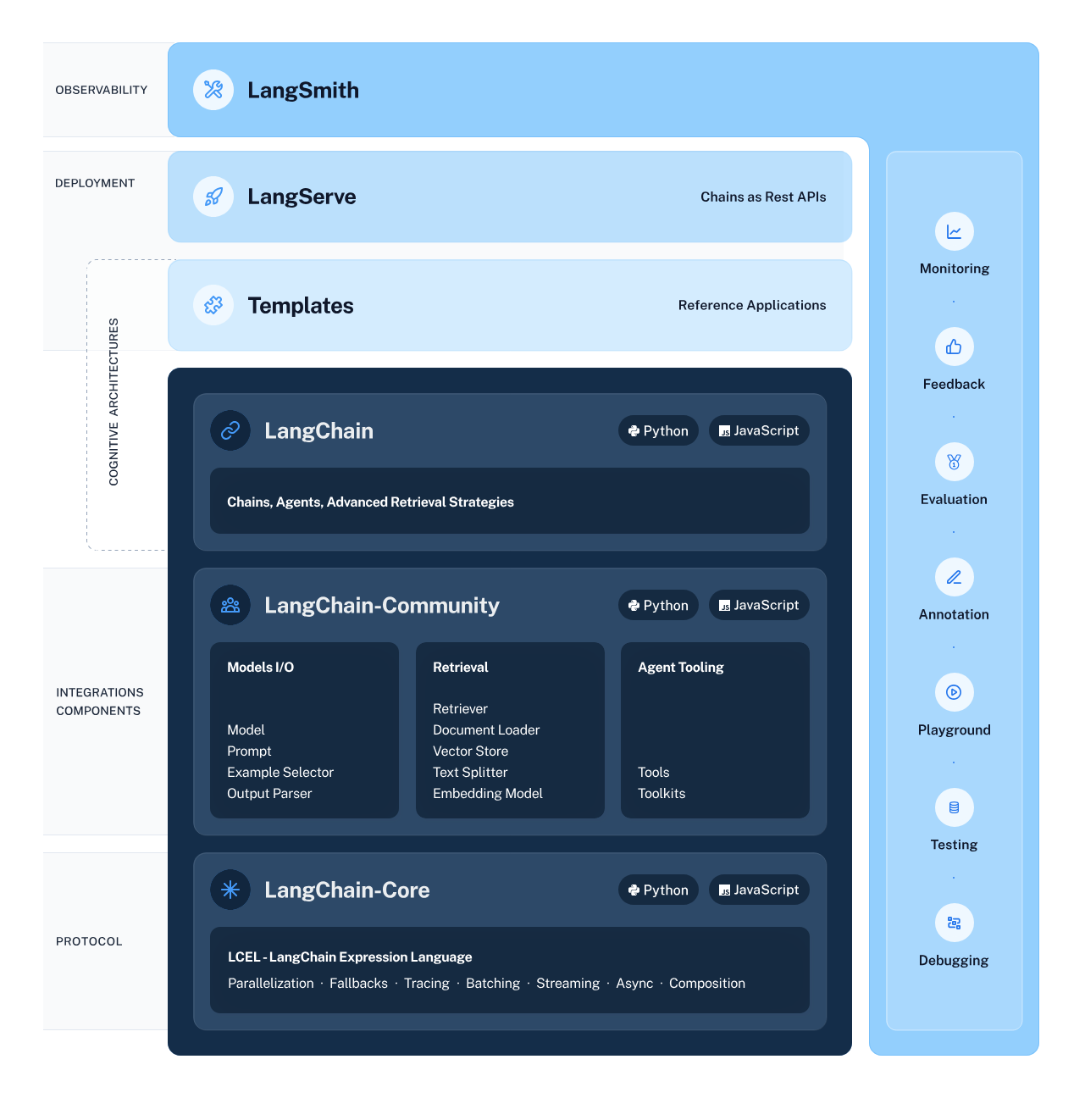
9. Using the Langchain Framework

Slide 18
10. Setting up a basic RAG pipeline.
RAG: Retriever Augmented Generation.
Vector DB
Document chunks
LLM
Query
Output

Slide 19
11. Calling GPT4 after setting up Google Colab Secrets.
Answer:
* Partition of India: Impact of the event:India/Pakistan
* Sino-Indian War: Impact of the event:Border regions of India
* Indian Independence: Impact of the event:India
* Partition of Bengal: Impact of the event:Bengal
These events are connected in that they all involve conflicts that have occurred in India or its neighboring regions. The Partition of India and Indian Independence were major events that led to the formation of new countries and changed the political landscape of the region. The Sino-Indian War and the Partition of Bengal were conflicts that had a significant impact on the border regions of India.
1. **Partition of India (1947)**
- **Impact of the event:** The partition of India led to the creation of two separate nations, India and Pakistan. This event resulted in one of the largest mass migrations in human history and significant communal violence.
- **Place Name:** The partition affected multiple regions but primarily Punjab and Bengal, which were split between the two new nations.
- **Type of Event:** It was a political and social upheaval event.

Slide 20
12. Generating and executing SQL queries with GPT 4.
User question
Results
GPT4
Select * from world_events
SQL DB
GPT4
Schema

Slide 21

Welcome to our world of AI!

